Slide 1
Unbelievable?
Are Christianity and science at odds?
Is there really evidence for God?
Notes:
The Bible App is your best, most complete source for the notes, especially the scripture references. The physical program is set up so that you have freedom to decide what to record in each of the four major segments of the message today. The insert is geared towards next steps at the end of the message.
Lots of assaults on God’s word, especially since the Enlightenment. I like facts and evidence to support my beliefs, so share tangible(?) reasons to believe. Don’t have nearly enough time to get to more than a fraction of it all, but my hope is that what’s shared today helps you see that the evidence we see in the real world agrees with Biblical assertions and encourages you to dig deeper on your own.

Slide 2
Some Terms…
science - knowledge
religion - a set of beliefs
faith - belief in something
morality - principles for telling right from wrong
God of the Gaps - if origin unclear or explanation incomplete, then “God” explains it
(a form of reasoning that attempts to explain phenomena that science hasn't yet explained by attributing them to divine intervention)

Slide 3
A Few Kinds of Arguments against the God of the Bible
Biblical Errancy - the Bible disagrees with itself (or makes questionable claims)
Bible vs. Science - the Bible disagrees with observable facts
Morality - God contradicts His own moral code
Christians’ Behavior - Like, eww…
Notes:
All kinds of arguments people launch against God. Some seem to confound God’s Word, at least at first, and others kind of don’t really have a clear-cut answer…

Slide 4
Biblical Errancy
The Bible claims to be the inspired words of a flawless being.
If the Bible can’t even agree with its own assertions, it’s a failed enterprise.
Two examples of commonly-used errancy arguments coming right up!
Notes:
Add the brilliance of the concentrated assaults on Genesis? If the foundation is bad, why bother with the rest? Or…if God is wrong from the start, when does he start telling the truth?

Slide 5
Biblical Errancy
Jesus restores a demon-possessed man
Matthew 18:28-34; Mark 5:1-20; Luke 8:26-39
Two potential issues:
How many demon-possessed men?
Where’d it happen?
Notes:
Bring cups or Hot Wheels or something to demonstrate that there’s still one there if there are two there.

Slide 6
Biblical Errancy
How many demon-possessed men?
Matthew = 2 demon-possessed men cured
Mark and Luke = 1 demon-possessed man cured
Notes:
Reveal first picture and ask how many weird German teacher Bitmojis everyone sees.
Reveal second picture and ask how many weird German teacher Bitmojis everyone sees.

Slide 7
Biblical Errancy
Where’d it happen?
Matthew = Region of the Gadarenes
Mark and Luke = Region of the Gerasenes
Notes:
Did Christian scribes not know how to spell? Did Jesus’ disciples not know where they were?! Is the Bible caught in a lie?!?

Slide 8
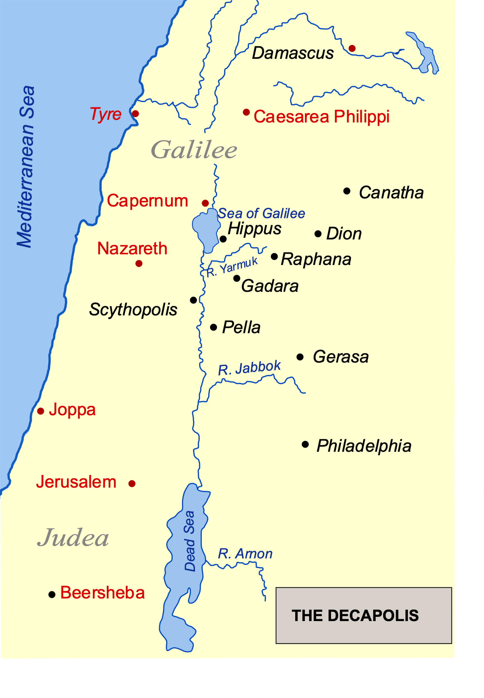
Biblical Errancy
Where’d it happen?
Matthew = Region of the Gadarenes
Mark and Luke = Region of the Gerasenes

Slide 10
Biblical Errancy
Unicorns!
No, seriously!
And the unicorns shall come down with them, and the bullocks with the bulls; and their land shall be soaked with blood, and their dust made fat with fatness. Isaiah 34:7 KJV
A unicorn to King Jimmy was a wild ox.
Languages change, duh…

Slide 11
Bible vs. Science
Are the God of the Bible and science incompatible?
What are their definitions?
Bible = God’s historical record and prophetic book
science = knowledge
What are their purposes?
Bible = to share The Creator’s account of events from our creation to our eternal state
science = for people to use to understand the universe
Notes:
Let’s make sure we’re all on the same page here and understand what the claim is.

Slide 12
Bible vs. Science
Firstly, are God and science mutually exclusive?
Consider this illustration:
Albert Einstein created the Theory of Special Relativity.
We don’t have to choose between believing in Einstein OR the Theory of Special Relativity. NO ONE in their right mind would say you do!
If God created the scientific laws of the universe, we CAN believe in both God and science. No problem here.
Notes:
Lots of people out there assert or even believe that you can have either God OR science.

Slide 13
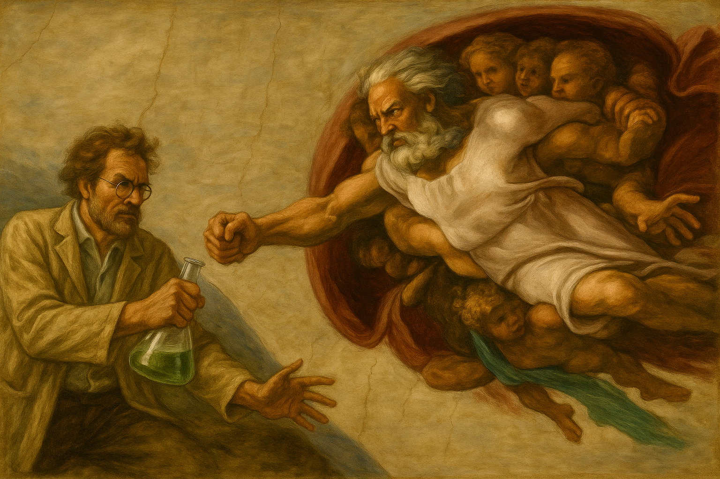
Bible vs. Science
But does the Bible contradict our observable universe?
Two oft-cited examples:
Noah’s Flood
Evolution
Notes:
Are Biblical claims and good science at odds with one another?

Slide 14
Bible vs. Science
The Flood
In small-ish groups, discuss these hang-ups for many people:
How could it rain for 40 days and 40 nights? (Right side of the sanctuary)
Genesis 1:6 and 7:11-12
How could every species of animal fit on the ark? Dinosaurs, too? (L side)
Genesis 7:14
Where’d the water go? (Everybody!)
Notes:
Give them 2 minutes to discuss, having left side do rain, right side species, and both sides do water; mention the BAM! kids and their expertise. Water’s whereabouts and Harvard Gazette: Earth may have been a water world 3 billion years ago on next slide

Slide 15
Bible vs. Science
The Flood
In small-ish groups, discuss these hang-ups for many people:
How could it rain for 40 days and 40 nights?
Genesis 1:6 and 7:11-12
How could every species of animal fit on the ark? Dinosaurs, too?!?
Genesis 7:14
Where’d the water go?
mountains and much of the land higher now; underwater oceans; ringwoodite
Harvard Gazette: Earth may have been a water world 3 billion years ago
Notes:
Picture of online article on next slide.

Slide 16
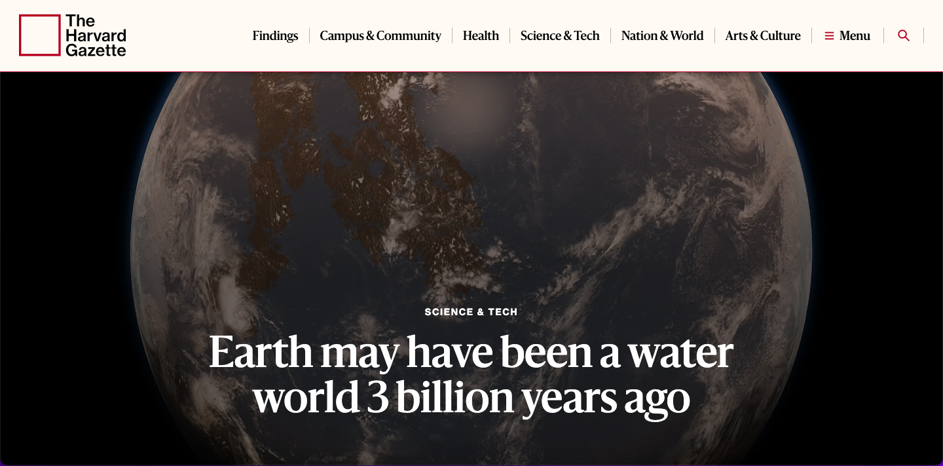

Slide 17
Bible vs. Science
Evolution
What kind of evolution? Micro- or macro-?
“Macroevolution” is what atheistic evolutionists believe happened; that is, the origin of all species from a single, simple ancestor cell. (*Dr. James Tour)
Necessary for this is new and useful information being added into DNA.
Richard Dawkins was asked for an example of a genetic mutation that increases the information in the genome. Click here for the epic response.
“Microevolution” is a real, observable process, and is how we get lots of species from one kind, as mentioned in the slides about Noah’s Flood.
Notes:
Check in with Jake and Shannon about video actually playing.
Dawkins’ epic and CORRECT response. Keep in mind that this is the ENGINE that makes macroevolution RUN.

Slide 18
Morality (or lack thereof?)
Is God a moral monster? Some sure seem to think so…
“The God of the Old Testament is arguably the most unpleasant character in all fiction: jealous and proud of it; a petty, unjust, unforgiving control-freak; a vindictive, bloodthirsty ethnic cleanser; a misogynistic, homophobic, racist, infanticidal, genocidal, filicidal, pestilential, megalomaniacal, sadomasochistic, capriciously malevolent bully.” -Excerpt from The God Delusion by Richard Dawkins
Notes:
Seems like Professor Dawkins is having some big feels on the subject.
Now, let’s explore.

Slide 19
Morality (or lack thereof?)
God Orders the Annihilation of the Canaanites
¹⁶ However, in the cities of the nations the Lord your God is giving you as an inheritance, do not leave alive anything that breathes. ¹⁷ Completely destroy them—the Hittites, Amorites, Canaanites, Perizzites, Hivites and Jebusites—as the Lord your God has commanded you. -Deut 20:16-17 (NIV)
Notes:
Sounds awful, right? How could a loving God order such a thing? CLICK!
(Deut 7:1-2 is similar)

Slide 20
Morality (or lack thereof?)
God Orders the Annihilation of the Canaanites
¹⁶ However, in the cities of the nations the Lord your God is giving you as an inheritance, do not leave alive anything that breathes. ¹⁷ Completely destroy them—the Hittites, Amorites, Canaanites, Perizzites, Hivites and Jebusites—as the Lord your God has commanded you. ¹⁸ Otherwise, they will teach you to follow all the detestable things they do in worshiping their gods, and you will sin against the Lord your God. -Deut 20:16-18 (NIV)
Notes:
Do it or they will pull you back into the filth (lie, cheat, steal, child sacrifices…)
It’s for their and therefore all humanity’s good, b/c The Messiah is coming through them.
God didn’t cause our situation, and He doesn’t murder, He kills in judgment, AND it’s not the final act; it’s simply a change in location.

Slide 21
Morality (or lack thereof?)
Our Moral Standard
Everyone is ingrained with a sense of right and wrong; good and evil.
Without an objective standard of meaning and morality, life is ultimately meaningless and right and wrong are simply a matter of opinion.
It either comes from a higher power or it evolved…
Notes:
Whatever works for you!
Different strokes for different folks!
You do you!
Live your best life!

Slide 22
Morality (or lack thereof?)
An Evolved Moral Standard?
Morals help us survive as a species.
If individuals ultimately decide, then…
…no one is truly right or wrong.
If societies ultimately decide, then…
…we’d be forced to accept whatever a society declares right or wrong as right or wrong for that society.
Notes:
Atheists would posit that morals benefit us and so would have been coded into our genes for better survival chances.
IF our moral standard evolved, then there are two possibilities:
I/O apply it to mass murderers (John Wayne Gacy, Dahmer), Epstein, or embezzlers.
Societal apply it to Nazi Germany or Shariah Law or to ancient Aztecs or…

Slide 23
Morality (or lack thereof?)
A Moral Standard from a Higher Power?
Morals help us bear His image properly to all creation.
If a moral standard giver ultimately decides, then…
…there is truly right and wrong.
…entire societies can be wrong.
Notes:
Image bearing in comparison with a simple survival mechanism.
Apply it to mass murderers (John Wayne Gacy, Dahmer), Epstein, or embezzlers and Nazi Germany or Shariah Law or to ancient Aztecs again…
There is no land where murder is virtue and gratitude vice. (C.S. Lewis); country where people admired for backstabbing those who had just helped them or running away from a child drowning another child in a kiddie pool
(Say this? Not “proof”, because it could have “just evolved this way”, but which argument holds more water?)

Slide 24
Morality (or lack thereof?)
Christians Are Often Incredibly Off-Putting
Hypocritical
Arrogant
Sanctimonious
Aggressive
What a deterrent!
Notes:
Show of hands; who’s been appalled by the behavior of a Christian (or “Christian”) before?
Counter this by daily recognizing that our salvation is a gift that we in no way deserve. What we deserve is eternal separation from God with all those who want to keep their crowns for themselves.
Since morality is universal, ALL of us are put-off when others rudely exclude us.
I’d say this deters at least as effectively as seeds of doubt about the veracity of God’s Word and our own hearts’ selfish desires.
Here we get an weird, apathetic German teacher Bitmoji at a dumpster fire.

Slide 25
God of the Gaps
“If I can’t find a rational explanation, then “God” must have done it.
Implies that Christians (and others) are ignorant and have blind faith.
Ignorant?
Flood evidence, the Goldilocks Principle, the language of DNA coding, everything created from nothing…
Faith?
Atheists believe that Atheism is true. Atheists have faith in their religion.
Notes:
Christian scientists making a splash: John Lennox, Stephen Myers, James Tour, Frank Turek, Wes Huff, Ken Ham, Hugh Ross; made a splash: Newton, Kepler, Linnaeus, Bacon, Copernicus; Groups: Answers in Genesis, Genesis Apologetics
Christians admit they have faith; Atheists like to pretend that they don’t.
Remember, what is faith? -A belief in something.
Remember, what is religion? -A set of beliefs
So, what is Atheism? A RELIGION that requires FAITH.

Slide 26
Next Week
Why do really, really smart people ignore real, actual facts, reject our loving Creator, and buy into things like atheistic evolution?
We’ll get at the “heart” of the matter.
Notes:
Remember, what is faith? -A belief in something.
Remember, what is religion? -A set of beliefs
So, what is Atheism? A RELIGION that requires FAITH.

Slide 27
Next Steps
Take a look at the program insert and do some exploring. Share with us next week if you feel so compelled!
Get ready for a conversation with someone you know about their doubts regarding The God of the Bible.
Reach out to someone for a conversation about their doubts regarding The God of the Bible.
Notes:
Remember, what is faith? -A belief in something.
Remember, what is religion? -A set of beliefs
So, what is Atheism? A RELIGION that requires FAITH.

